Slide 1




Slide 2
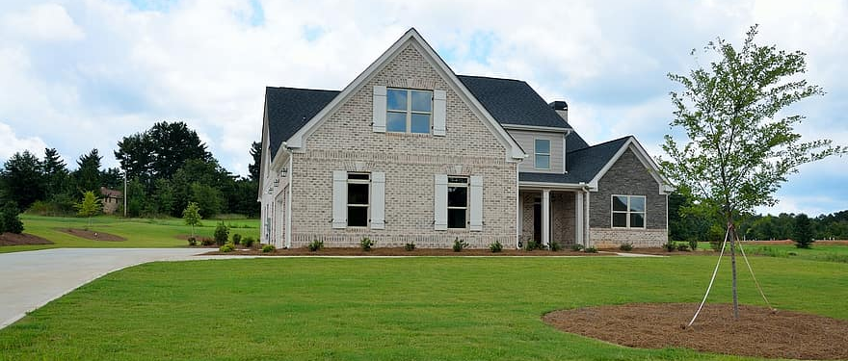
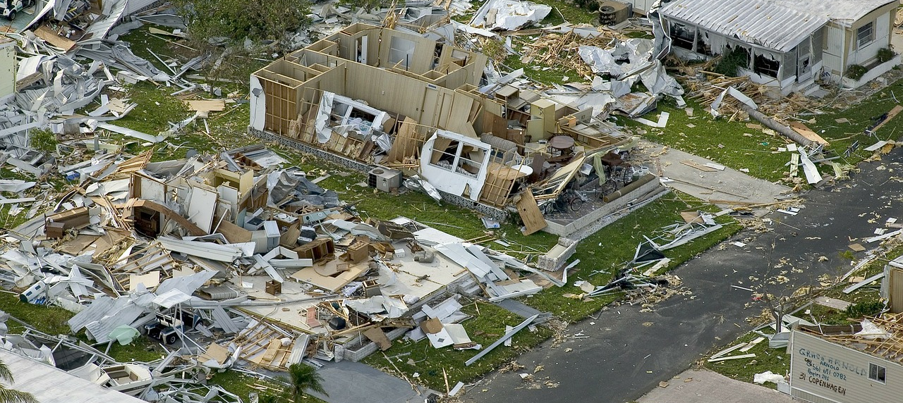
HOMEOWNER REHABILITATION
AND
DISASTER RECOVERY
PROGRAMS
Presented by
Jackie Cobbins

Slide 3
HOME PROGRAM BACKGROUND
Under the HOME Investment Partnerships Program, the Department of Housing and Urban Development allocates funds to eligible State and local governments to strengthen public-private partnerships. Also to expand the supply of decent, safe, sanitary, and affordable housing, for low-income and very low-income families. Funds may be used to carry out multi-year housing through acquisition, rehabilitation, and new construction of housing, as well as tenant-based rental assistance.

Slide 4
HOMEOWNER REHABILITATION
The Homeowner Rehabilitation Program is a program which allows the use of funds to assist existing low and very low-income eligible homeowners with the rehabilitation, replacement, or reconstruction of owner-occupied units.
Funds are distributed Statewide in accordance with the State’s Consolidated Plan and the One-Year Action Plan.

Slide 5

HOMEOWNER REHABILITATION
Applications Accepted Annually
Eligible Applicants – Local Units of Government and Non-Profits
Funds Distribution – Competitive Process
Maximum Award Request – $600,000

Slide 6

NEW AND NOTABLE
Funds Format – Forgivable Grant
  Reservation Letter
  15-Month Benchmark

Slide 7
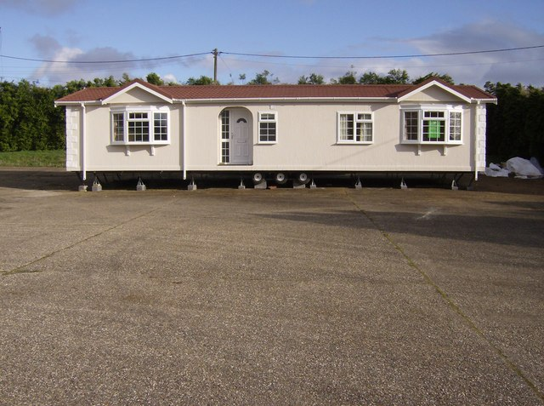
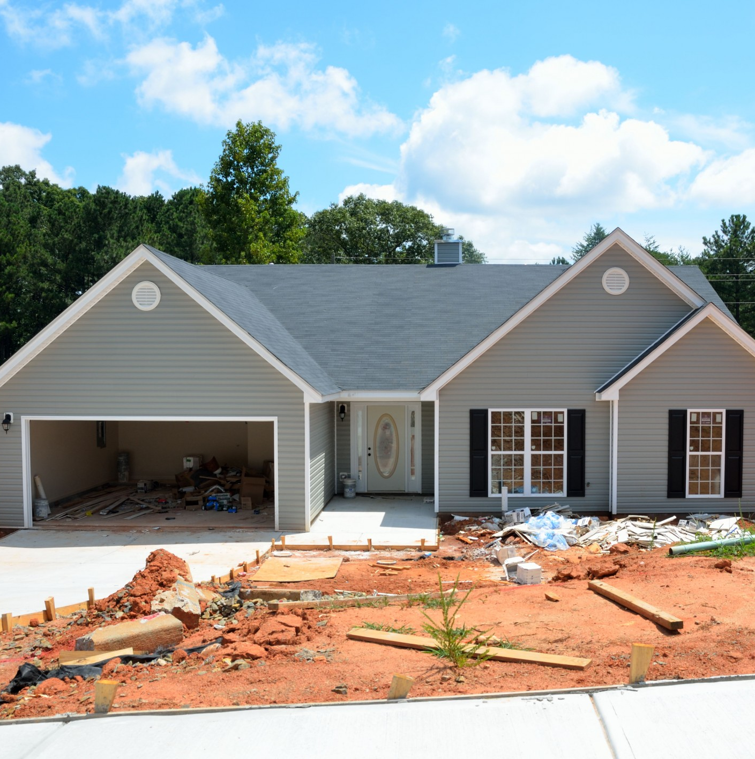

HOMEOWNER REHABILITATION
Eligible Activities
Rehabilitation – Repair major deficiencies affecting safety and habitability.
Reconstruction/Replacement – Replacement of existing housing unit.

Slide 8
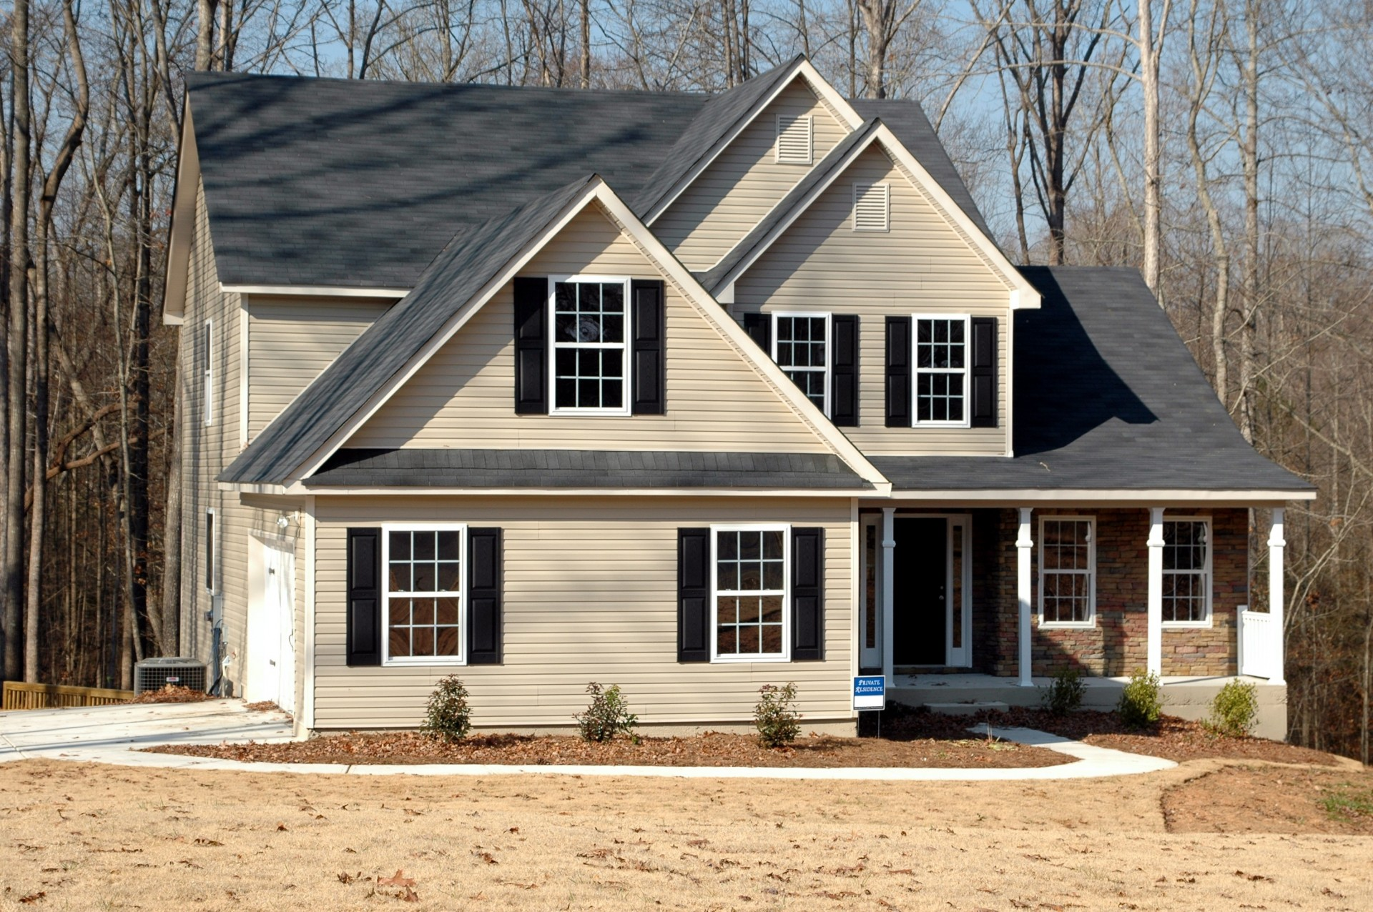
HOMEOWNER REHABILITATION
Period of Affordability
    Rehabilitation – 5 years
    Reconstruction – 10 years
    Replacement – 10 years

Slide 9

HOMEOWNER REHABILITATION
REQUIREMENTS
  Must occupy unit as principal residence
  Legal ownership of property
  Proof of owner occupancy – Prior 12 months
  Property must be a single-family, owner-occupied unit

Slide 10

HOMEOWNER REHABILITATION
ELIGIBILITY AND REQUIREMENTS
  Household must receive income to sustain housing throughout the affordability period.
  Property taxes must be current or exempt status.

Slide 11
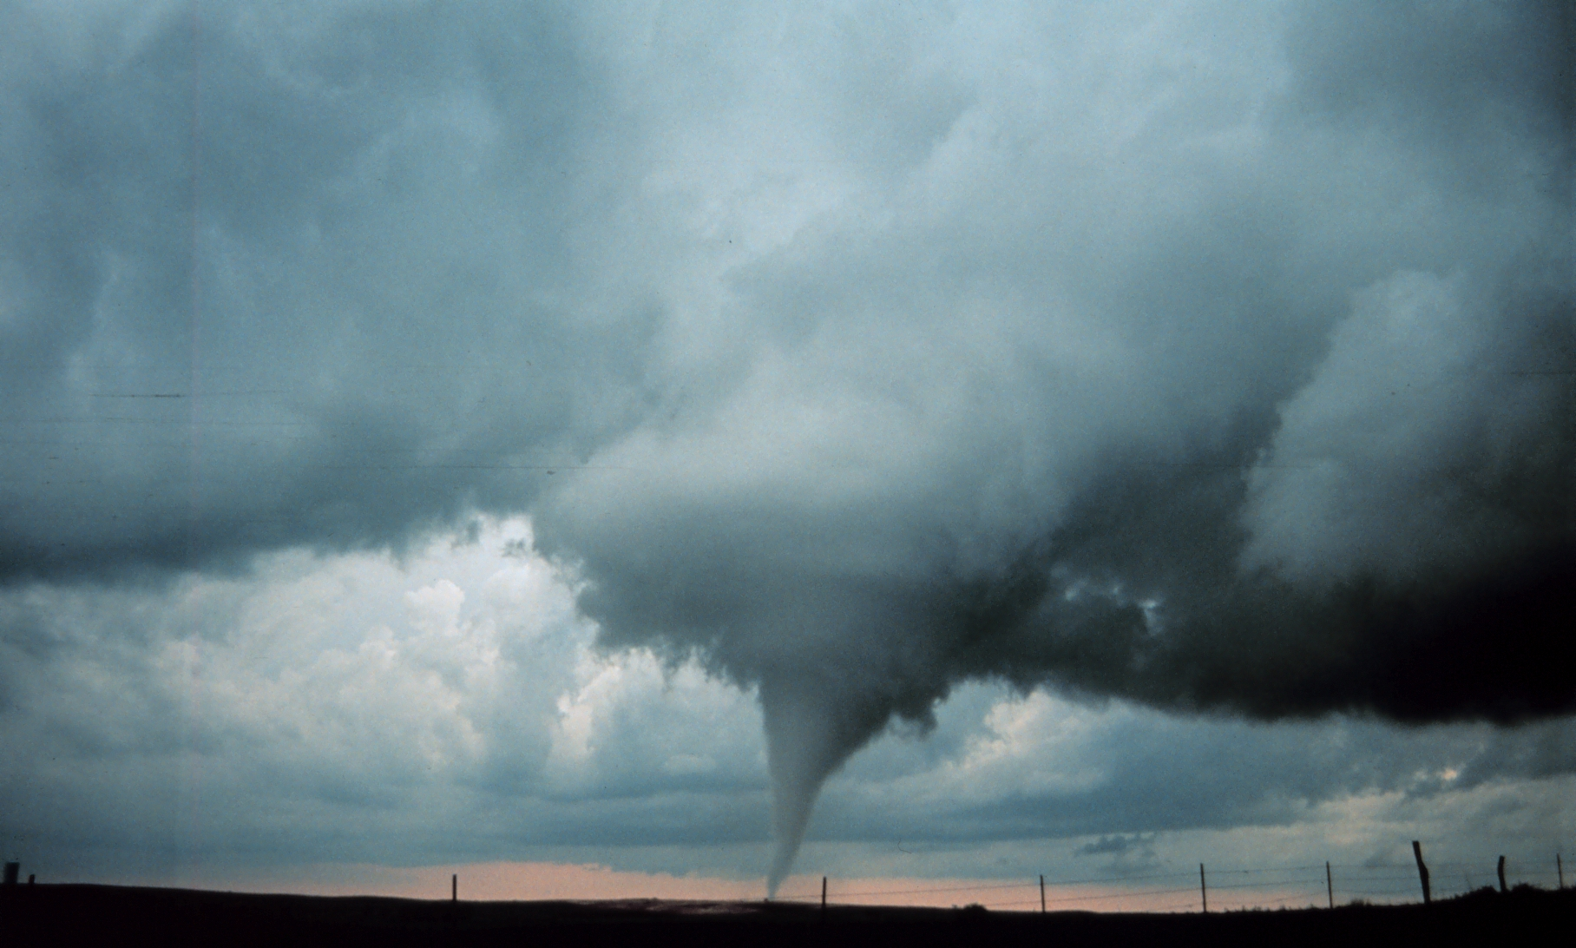
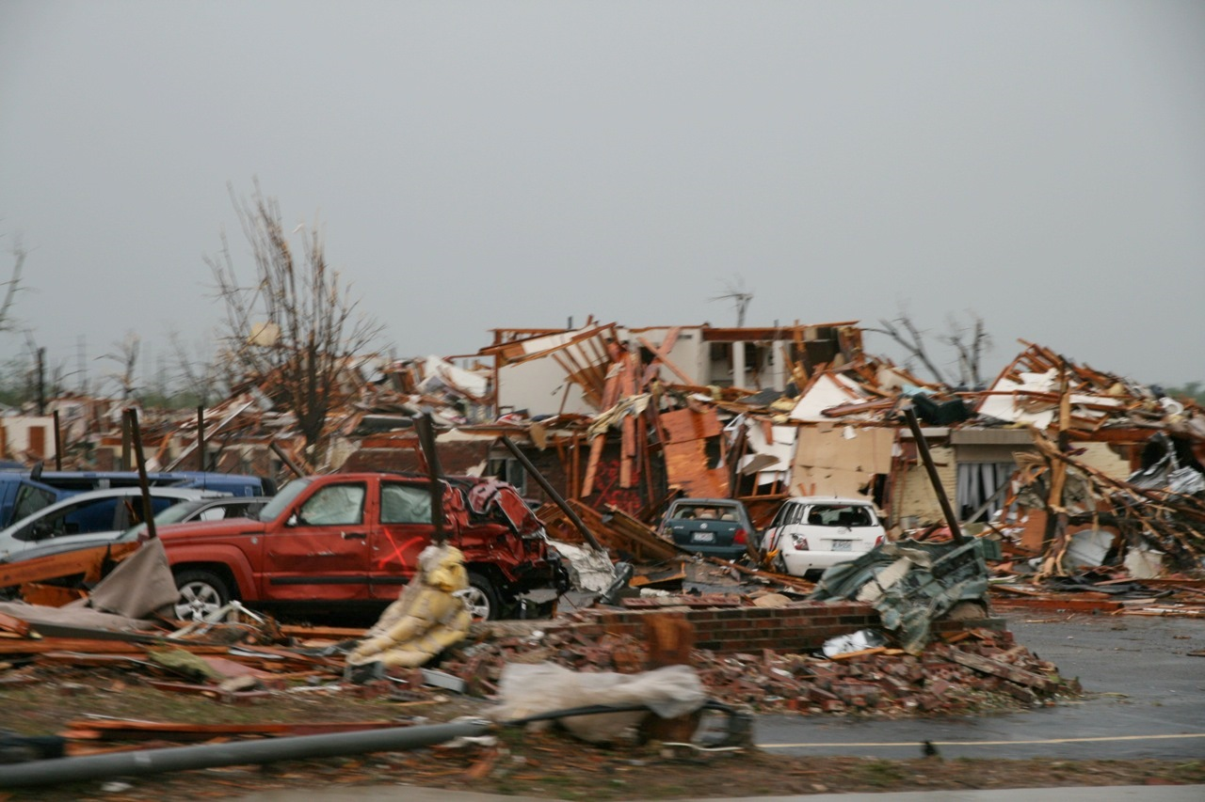
DISASTER RECOVERY PROGRAM
The HOME Disaster Recovery (DR) program provides housing assistance to counties in a declared area to low-income households impacted by a disaster to help rebuild a community’s housing stock and encourage the resettlement of displaced homeowners.

Slide 12
DISASTER RECOVERY PROGRAM
DEGREES OF DAMAGE
AFFECTED – A home is considered affected if the damage to the home is mostly cosmetic.
MINOR – A home with repairable non-structural damage.
MAJOR – A home with structural damage or other significant damage that requires extensive repairs.
DESTROYED – The home is a total loss.

Slide 13
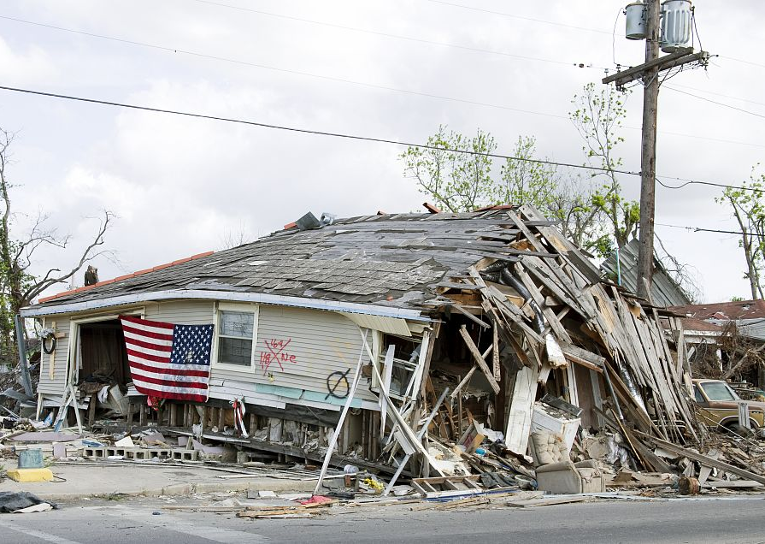
DISASTER RECOVERY PROGRAM
ELIGIBLE APPLICANT
  Counties Identified in a FEMA Declaration
ELIGIBLE ACTIVITIES
    Rehabilitation
    Repair
    Replacement

Slide 14
DISASTER RECOVERY PROGRAM
INELIGIBLE USE Of FUNDS
DR funds cannot be used to assist in immediate clean up or restoration of services in the aftermath of a disaster. Funds are a potential financing source for long-term housing recovery efforts.
Direct homeownership assistance to purchase a new stick-built home.
Tenant Based Rental Assistance (TBRA) Rental housing units.
Hotels or other temporary shelter that does not constitute housing.

Slide 15
DISASTER RECOVERY PROGRAM
Period of Affordability
    Rehabilitation – 5 years
    Reconstruction – 10 years
    Replacement – 10 years

Slide 16
DISASTER RECOVERY PROGRAM
REQUIREMENTS
  Must have occupied unit as principal residence
  Legal ownership of property
  Proof of owner occupancy – Prior 12 months
  Property must be a single-family, owner-occupied unit

Slide 17
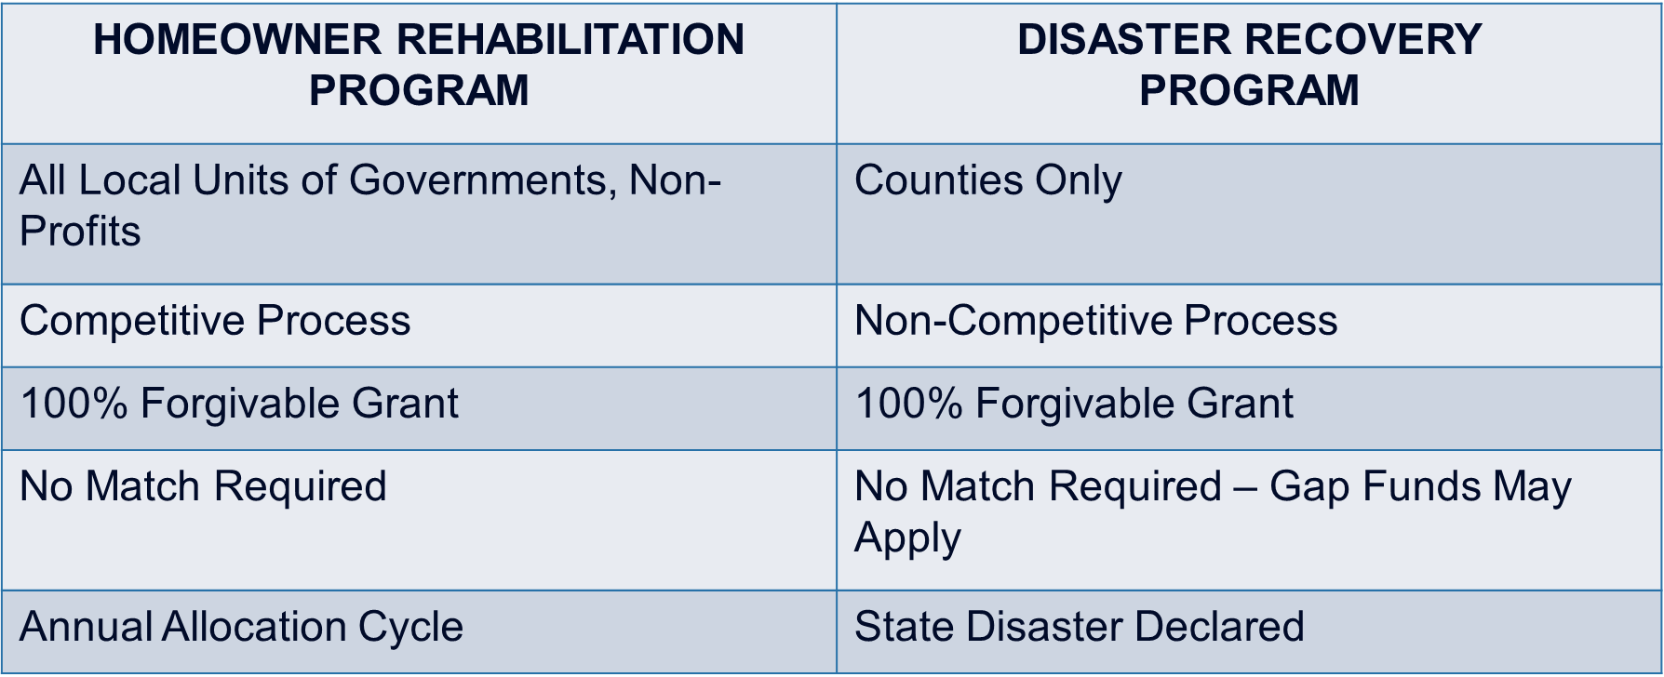
OVERVIEW
Homeowner Rehabilitation
vs
Disaster Recovery

Slide 18
Questions?

Slide 19

CONTACT INFORMATION
Jackie Cobbins
Federal Grants Program Coordinator
601-718-4635
jackie.cobbins@mshc.com
www.mshomecorp.com
www.mshomecorp.com/federal-programs/home/homeowner-rehab/

Slide 20

Thank you for attending!
58
Notes:
Questions?

